Slide 1
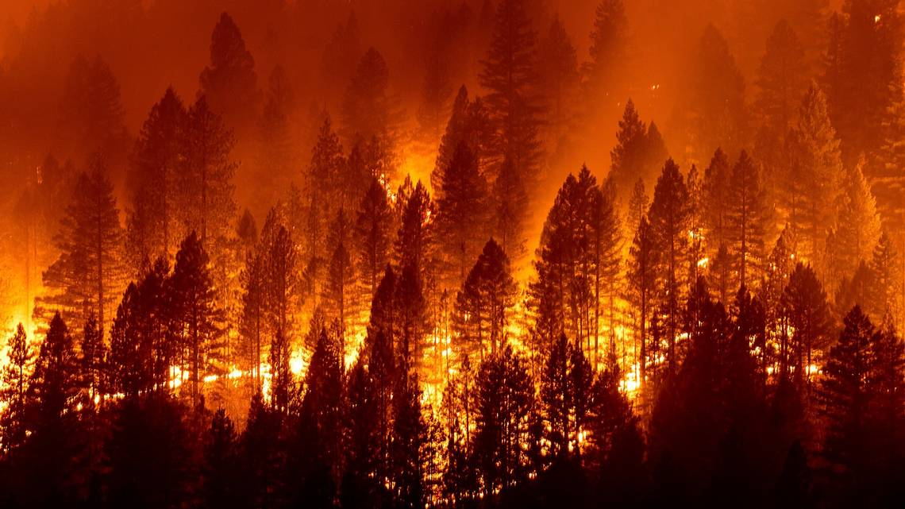
California Wildfires
Jinfang Li, Wendy Mudzinski, Stephen Tan, Rachel Tsuchiyama, Cassie Xu
https://github.com/stephen-tan/california-wildfires

Slide 2
Project Introduction

Slide 3
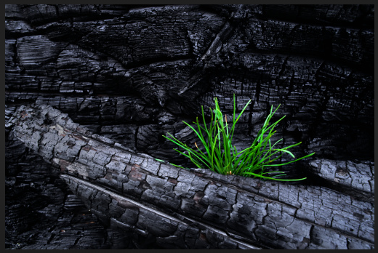
Why We Chose Wildfires
A high incidence of wildfires continuously in California.
A huge economic hardship and time consuming
a Incalculable personal injury and family broken.
Predict next fire can help people to prevent in advance.

Slide 4
Questions We Hope to Answer
Where and when could the next California wildfire be?
How does temperature play a role in fire season?
Are there specific counties that are more prone to wildfires?
What is the main factor to cause a wildfire?

Slide 5
Technologies &
Tools &
Languages &
Algorithms Used

Slide 6
Technologies & Tools
Visual Studio, JavaScript, PGAdmin, PostgreSQL DB
GitHub, Jupyter Notebook, Tableau
Machine Learning - Dense Neural Network, 6 layers, CCE-Categorical Crossentropy Loss

Slide 7
Description of Source Data
California Wildfires dataset from Cal Fire from Kaggle.com
California Counties Boundares geoJSON file from the CNRA - (California Natural Resources Agency)
Drought Data from the CNRA
Statistical Weather and Climate Information from the NOAA - (National Oceanic and Atmospheric Administration)

Slide 8
Data Exploration

Slide 9
Data Exploration Phase
Kaggle Wildfires Dataset - 40 fields
Kaggle Wildfires Dataset - 7 fields
Combined Dataset -
13 fields
Weather & Climate Information - 6 fields
Weather & Climate Information - 4 fields

Slide 10
Database Outline
California Wildfires (2013-2020) dataset
AcresBurned
Counties
Latitude
Longitude
Month
Year
California Rainfall dataset
Precipitation
Mean Temperature
Min Temperature
Max Temperature
Combined dataset
AcresBurned
Counties
Latitude
Longitude
Month
Year
Precipitation
Mean Temperature
Min Temperature
Max Temperature
+
=
Issue ⇒ No primary or foreign keys

Slide 11
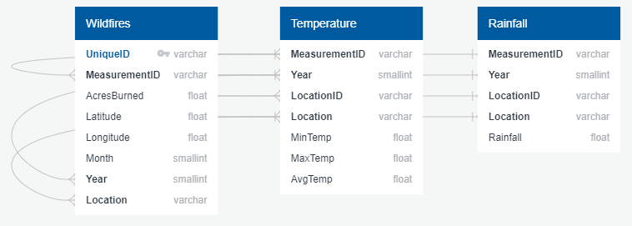
Entity Relationship Diagram
Created 2 unique fields for primary and foreign keys (PK and FK, respectively)
MeasurementID (FK) ⇒ Year—LocationID
UniqueID (PK) ⇒ Year—Month—MeasurementID—AcresBurned
PK
FK

Slide 12
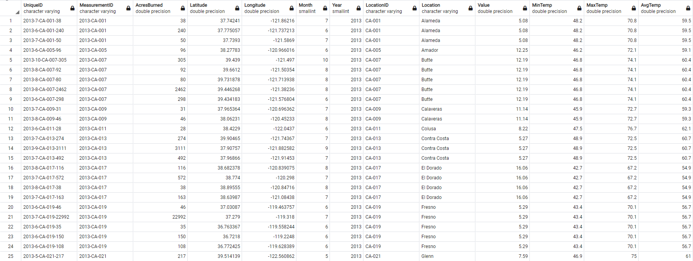
Final Database Overview
Kaggle Wildfire
Weather (Temperature, Rainfall) Data
PK

Slide 13
Analysis &
ML Algorithms

Slide 14
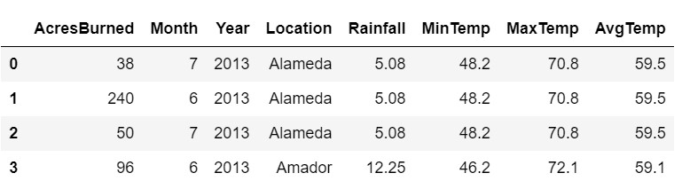
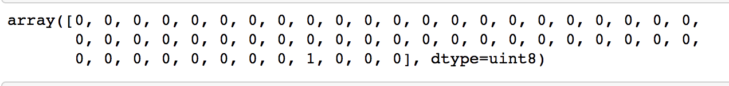
Analysis Phase
In order to determine the location of the next wildfire, we used our dataset to train a Dense Neural Network.
Features:
Labels: County names (converted to dummies)

Slide 15
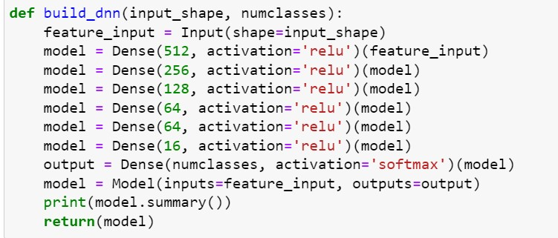
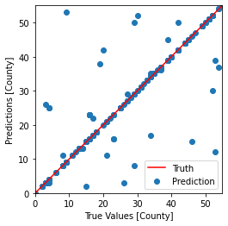
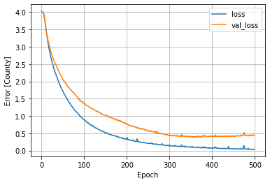
Our model was able to predict location of fires with 88% accuracy.
Test Results:
Notes:
Initial analysis shows that with the dataset provided, and with varying inclement challenges, it’s difficult to provide an absolute prediction. To some extent fires are started accidentally and can spread quite quickly due to it’s surrounding environment. Based on past data, our model shows that we can predict at 88% accuracy.

Slide 16
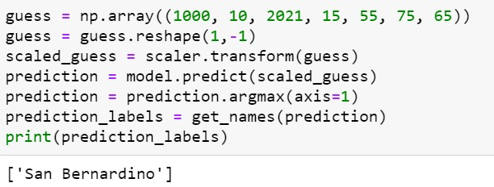
Therefore, we used our model to predict where a wildfire would start this month.
Notes:
Due to our insufficient amount of data, we were not able to predict when and where the next wildfire would be. We determined that more environmental data would increase the accuracy of our model.

Slide 17
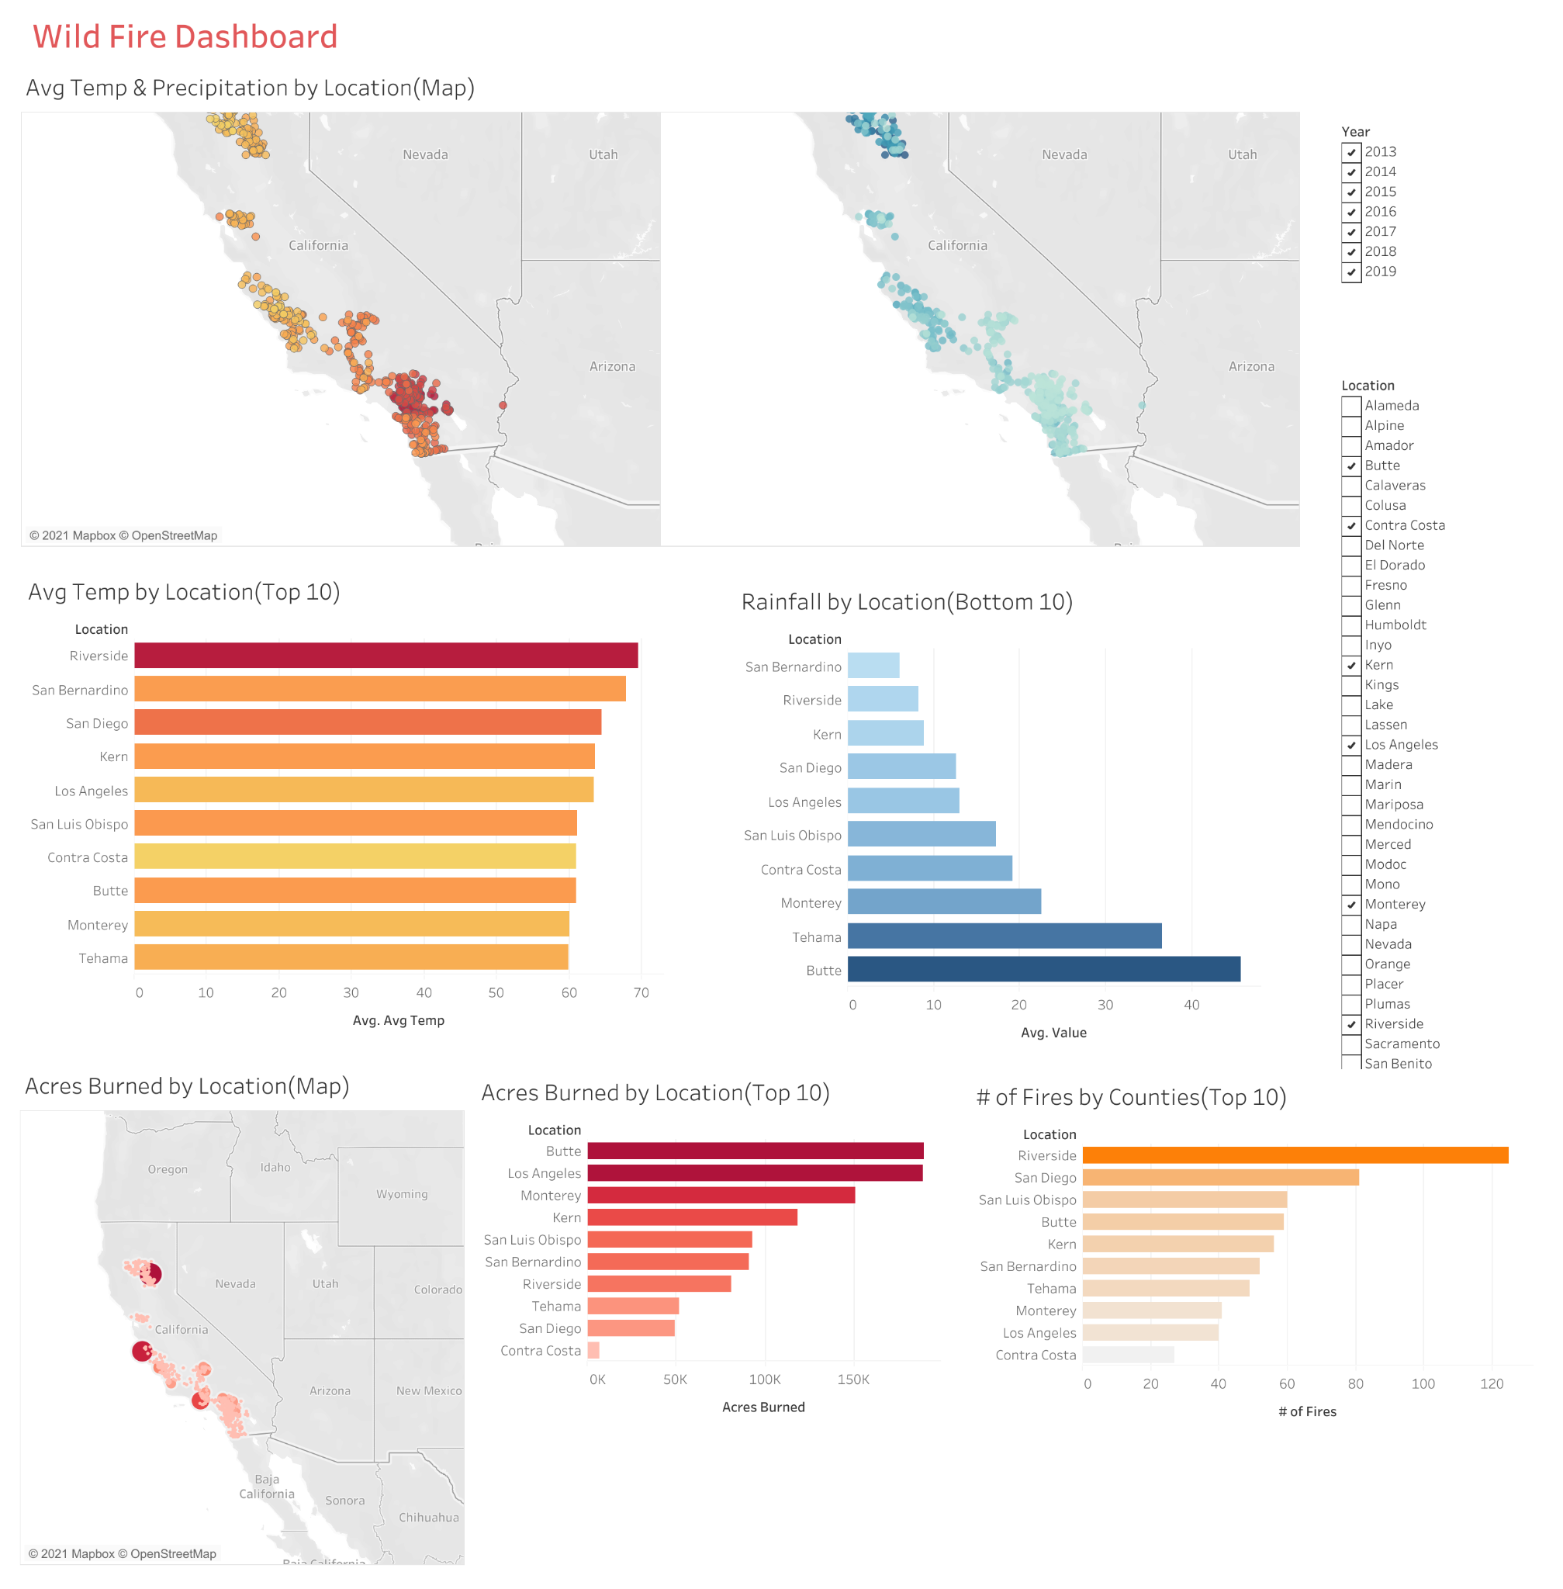
Tableau Dashboard

Slide 18
Lookback-What We Would Have Done Differently

